Slide 1

5W1H analysis of urban tranport problems
Group 9 – Bartłomiej Kubicki, Aleksander Włodarczyk, Zofia Majewska, Grzegorz Brochocki

Slide 2
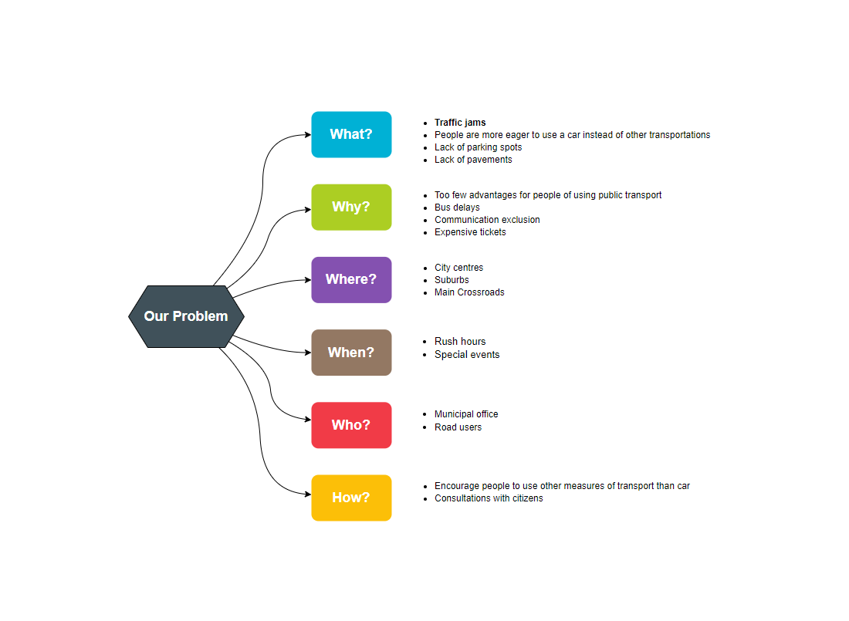
Diagram

Slide 3
WHAT
There are definitely too many cars on the streets these days. People mostly choose car transportation instead of any ways of transport. This results in more and more traffic jams, which became a serious problem for big cities. Also, most of the citizens are not willing to use any public transport. Because of that, it is almost impossible to find a parking space in the city centers so people are parking their cars on the pavements.

Slide 4
WHY
People are not eager to switch from their automobiles to other ways of transport, because they do not see many advantages of doing so. The buses and trams have huge delays and there are plenty of city areas difficult to reach using public transport. Moreover, in many cities, the ticket prices are really high.

Slide 5
WHERE
The problem mostly occurs in city centres, on large crossroads, and main roads and avenues. It also touches suburban roads where are frequently used by drivers to get to the city center.

Slide 6
WHEN
Traffic jams are the biggest especially during the rush hours, but they also happen before some special events such as Christmas, Easter etc.

Slide 7
WHO
People who have the most power in this area are municipal office officials, because they can make improvements in public transport in a given city. People who are suffering from great traffic jams and huge number of cars in the cities are in fact all the users of traffic movement.

Slide 8
HOW
Encouraging people to use other measures of transport instead of cars by giving them more advantages of doing so can diminish the number of automobiles in the urban areas. The social consultations should be carried out in order to know what benefits would satisfy the most certain groups of road users.

